Slide 1
HOSPITAL MANAGEMENT SYSTEM
Submitted in the partial fulfillment for the award of the degree of
BACHELOR OF ENGINEERING
IN
INTERNET_OF_THINGS
Submitted by: University Roll Number:
NIMISH SURI 20BCS4550
JANVI 20BCS4537
GURLEEN KAUR 20BCS4526
SATYAM SINGH 20BCS4553
UDIT SHUKLA 20BCS4571
Under the Supervision of:
RAJAT TIWARI MAM
Department of AIT-CSE
DISCOVER . LEARN . EMPOWER

Slide 2
Outline-
Introduction to Project
Problem Formulation
Objectives of the work
Methodology used
Results and Outputs
Conclusion
Future Scope
References

Slide 3
Introduction to Project-
The health sector aims at providing the best medical facilities to the common man.
Hospital Management System provides the benefits of streamlined operations, enhanced administration & control, superior patient care, strict cost control and improved profitability.
This system is powerful, flexible, and easy to use and is designed and developed to deliver real conceivable benefits to hospitals.
More importantly it is backed by reliable and dependable support.

Slide 4
Introduction to Project-
This hospital management system is a user friendly interface which facilitates the user to do several tasks in an easy and efficient way.
In our website we are covering several domains like appointment booking, medicine ordering, disease predictor, disease information, health camps details, Portal for blood donation and organ donation, a patient can contact us and can post feedback about our hospital facilities.
Also, we have made an ambulance facility option for convenience of patients.
This website provides a way to record the information of the patients and to access all these in a simple way.

Slide 5
Problem Formulation-
Taking into account all the mentioned details, we can make the conclusion that the hospital management system is the inevitable part of the lifecycle of the modern medical institution.
It automates numerous daily operations and enables smooth interactions of the users.
Developing the hospital system software is a great opportunity to create the distinct, efficient and fast delivering healthcare model.
Implementation of hospital management system project helps to store all the kinds of records, provide coordination and user communication.

Slide 6
Problem Formulation-
This beneficial decision covers the needs of the patients, staff and hospital authorities and simplifies their interactions.
It has become the usual approach to manage the hospital. Many clinics have already experienced its advantages and continue developing new hospital management system project modules.
Hospital management system is all about the modernizing a hospital through use of technology. Computers helps in it and take over the manual system for quick and easy functioning.
This hospital management system is a quite the reliable and is proven on many stages.

Slide 7
Objectives of the Work-
Main objectives of a Hospital Management System are: -
Design a system for better patient care.
Reduce hospital operating costs.
Provide MIS (Management Information System) report on demand to management for better decision making.
Better co-ordination among the different departments.
Provide top management in a single point of control.

Slide 8
Methodology used-
The following methodology will be followed to achieve the objectives defined for proposed research work:
Detailed study of “Hospital management system” will be done.
Various parameters will be identified to evaluate the proposed system.
Comparison of new implemented approach with exiting approaches will be done.
This website is designed to take care of such big projects.
Easy to manage due to rigidity of the model.
Simple and easy to understand and use.

Slide 9
Methodology used-
REQUIREMENT ANALYSIS
WEBSITE DESIGN
IMPLEMENTATION
SYSTEM DESIGNED
SYSTEM FULLY FUNCTIONAL
SYSTEM TESTING

Slide 10
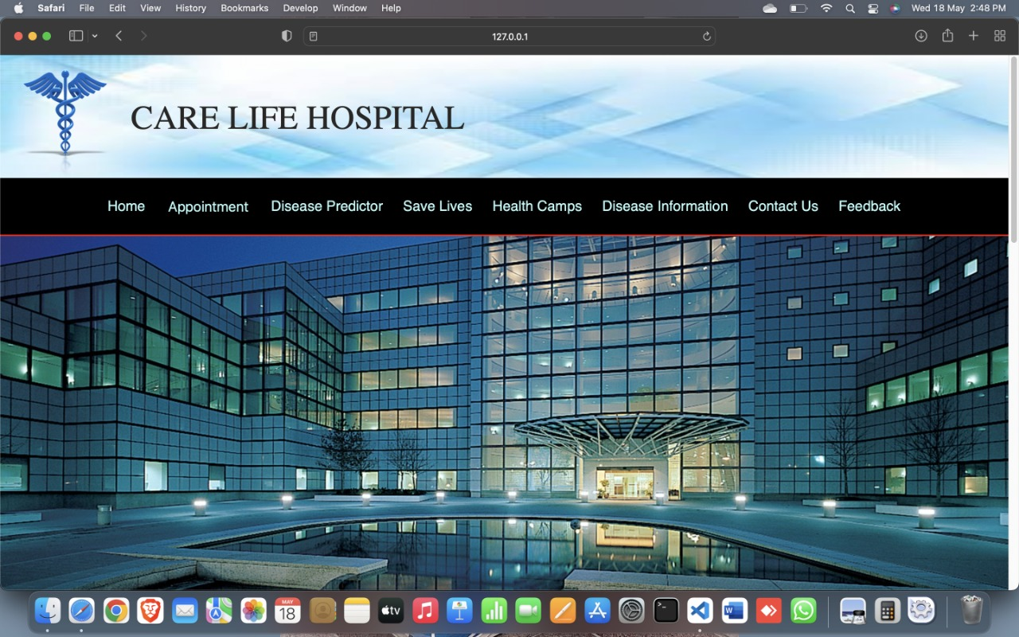
Results and Outputs- HOME PAGE-

Slide 11
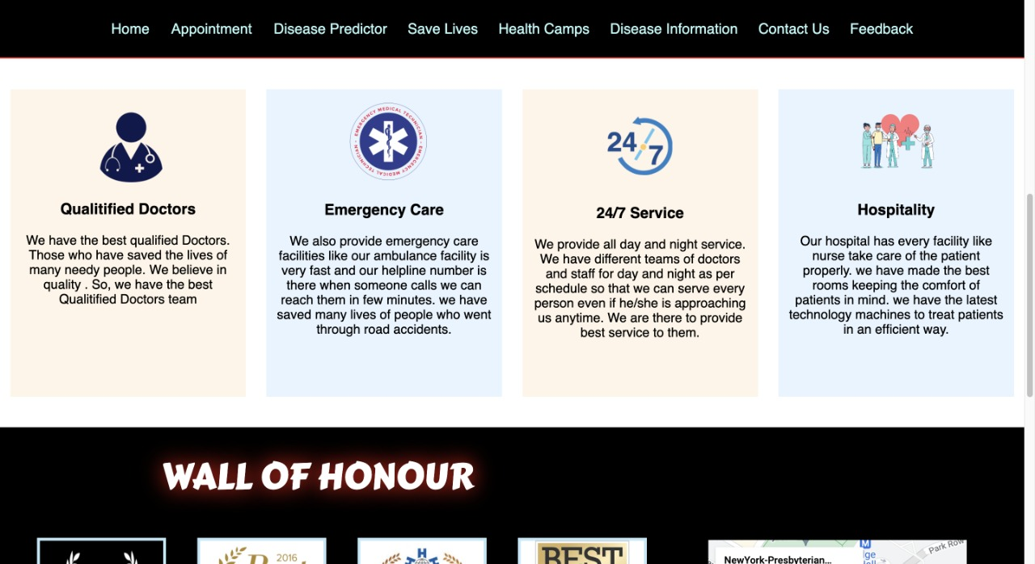
Results and Outputs- HOME PAGE (FACILITIES PROVIDED)-

Slide 12
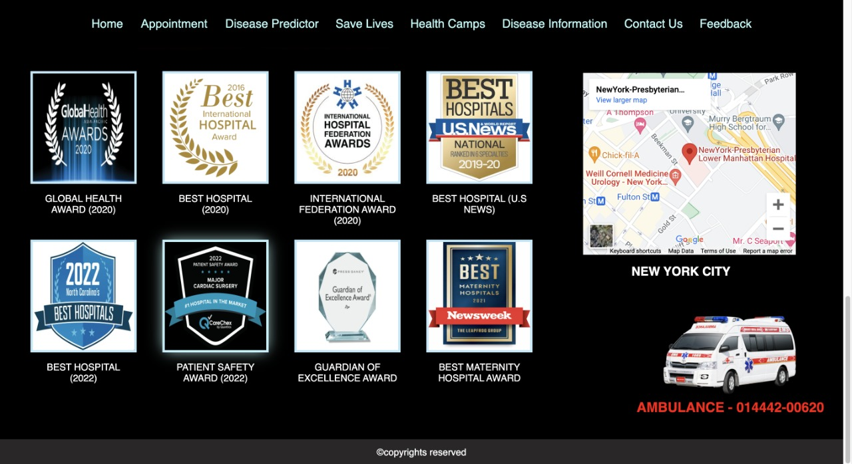
Results and Outputs- HOME PAGE (WALL OF HONOUR)-

Slide 13
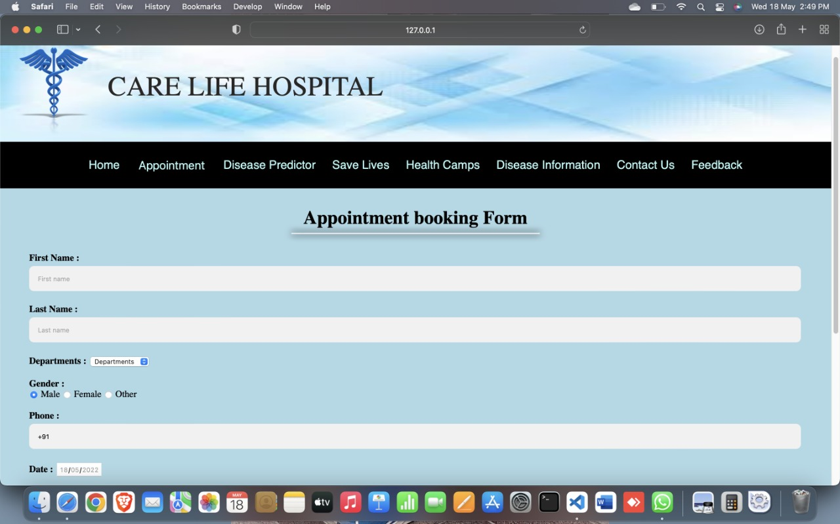
Results and Outputs- APPOINTMENT (BOOKING FORM)-

Slide 14
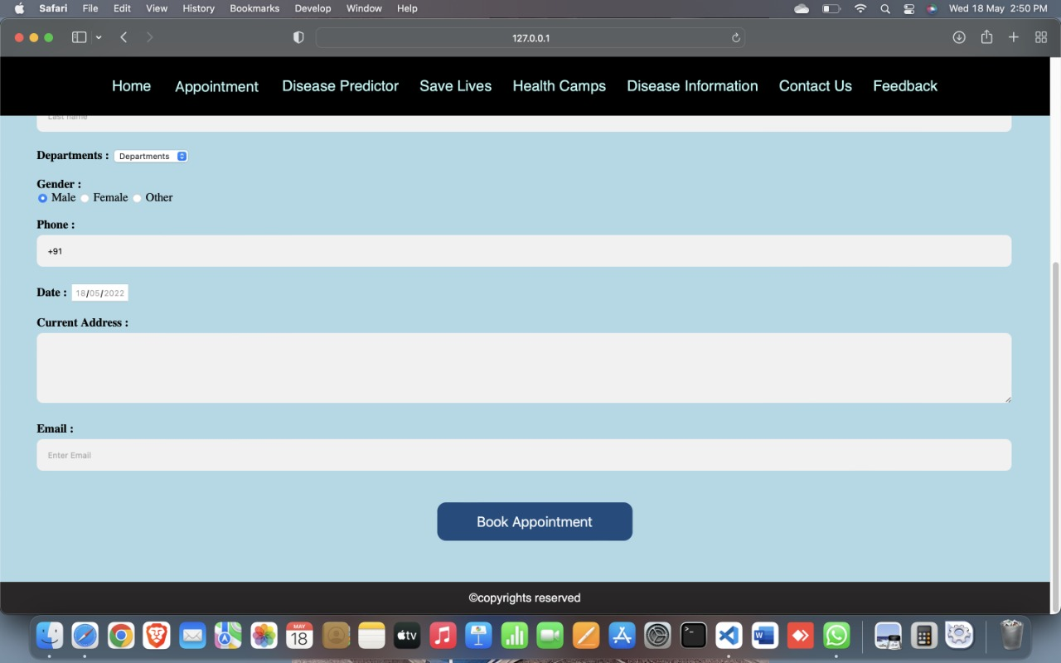
Results and Outputs- APPOINTMENT (ENTER YOUR DETAILS)-

Slide 15
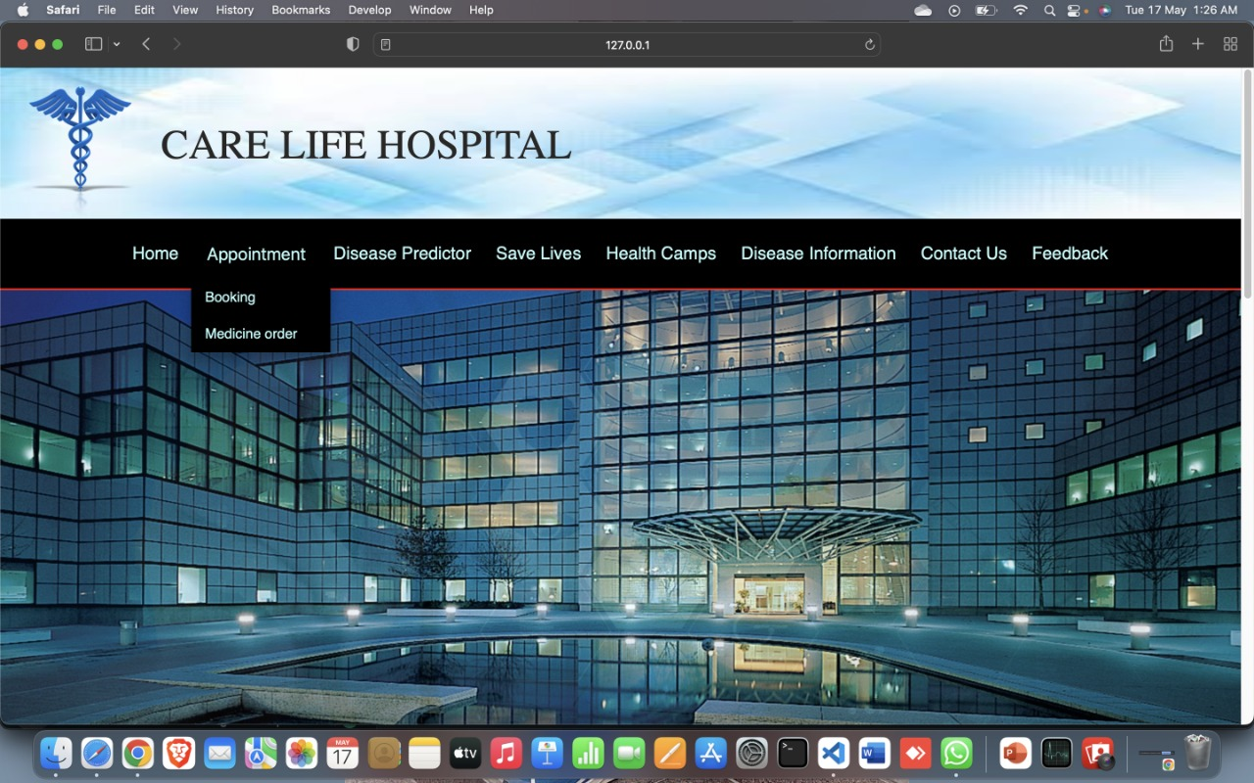
Results and Outputs- APPOINTMENT MENU (DROPDOWN)-

Slide 16
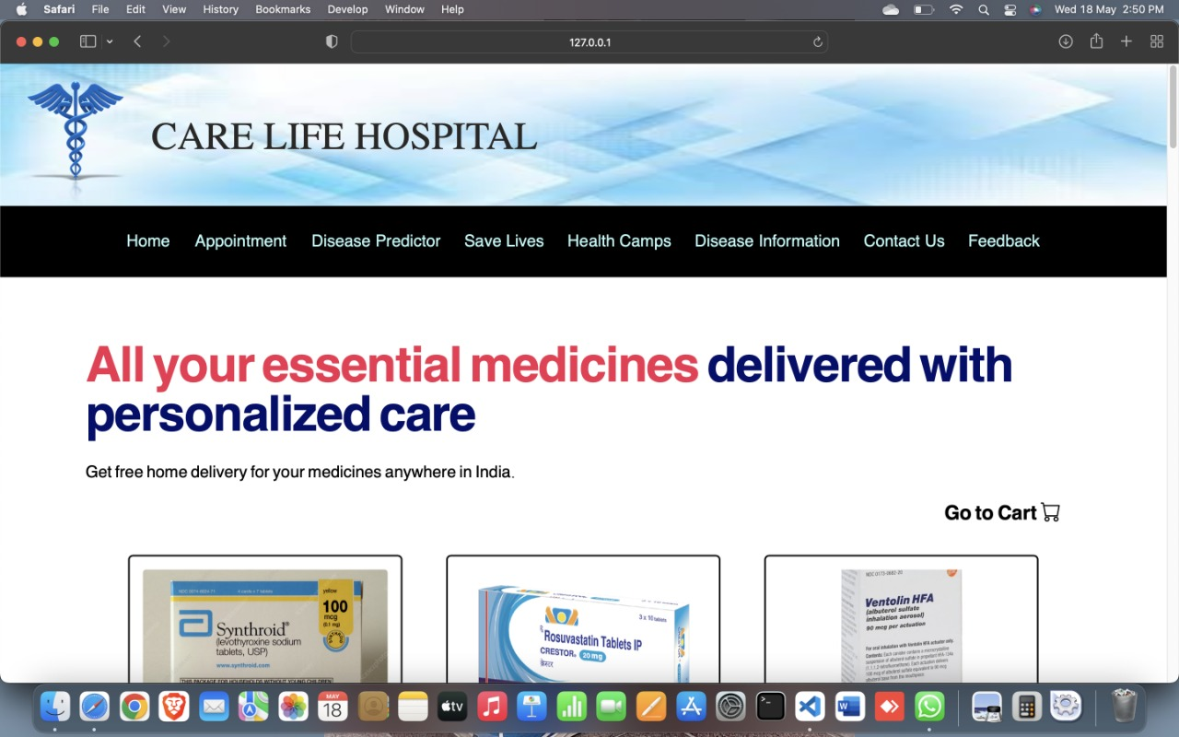
Results and Outputs- APPOINTMENT (MEDICINE ORDER)-

Slide 17
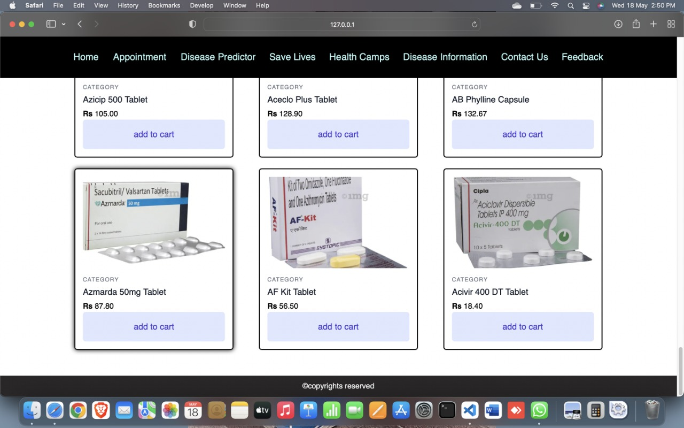
Results and Outputs- MEDICINE ORDER (MEDICINES AVAILABLE)-

Slide 18
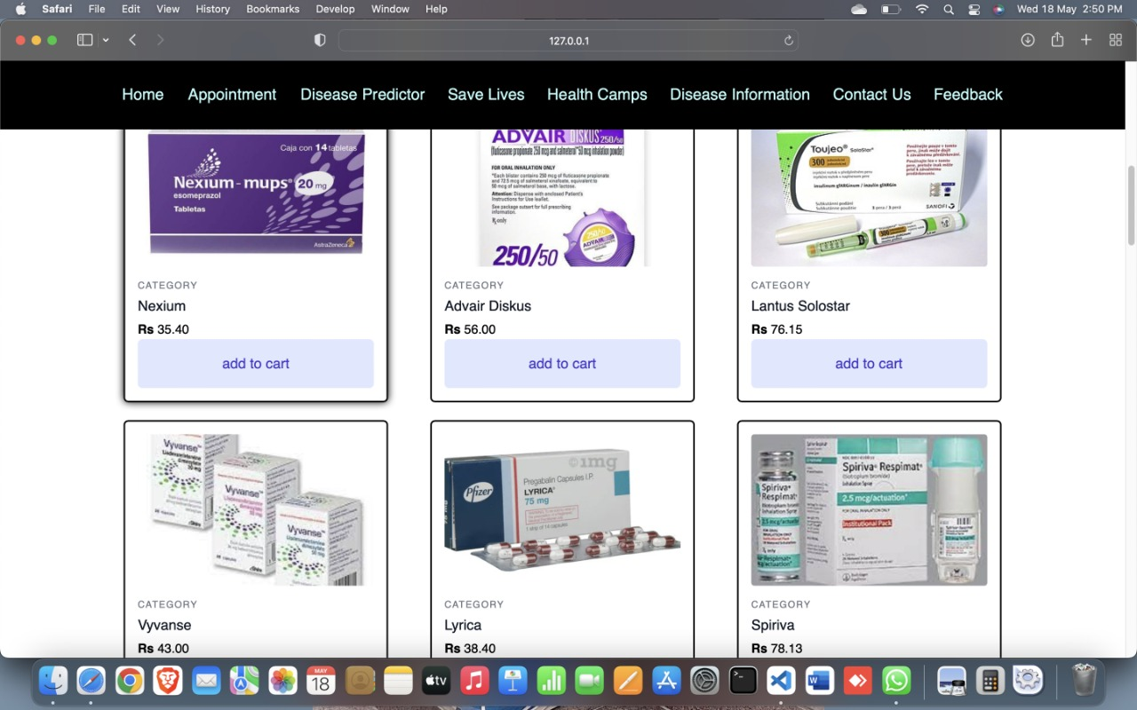
Results and Outputs- MEDICINE ORDER (MEDICINE AVAILABLE)-

Slide 19
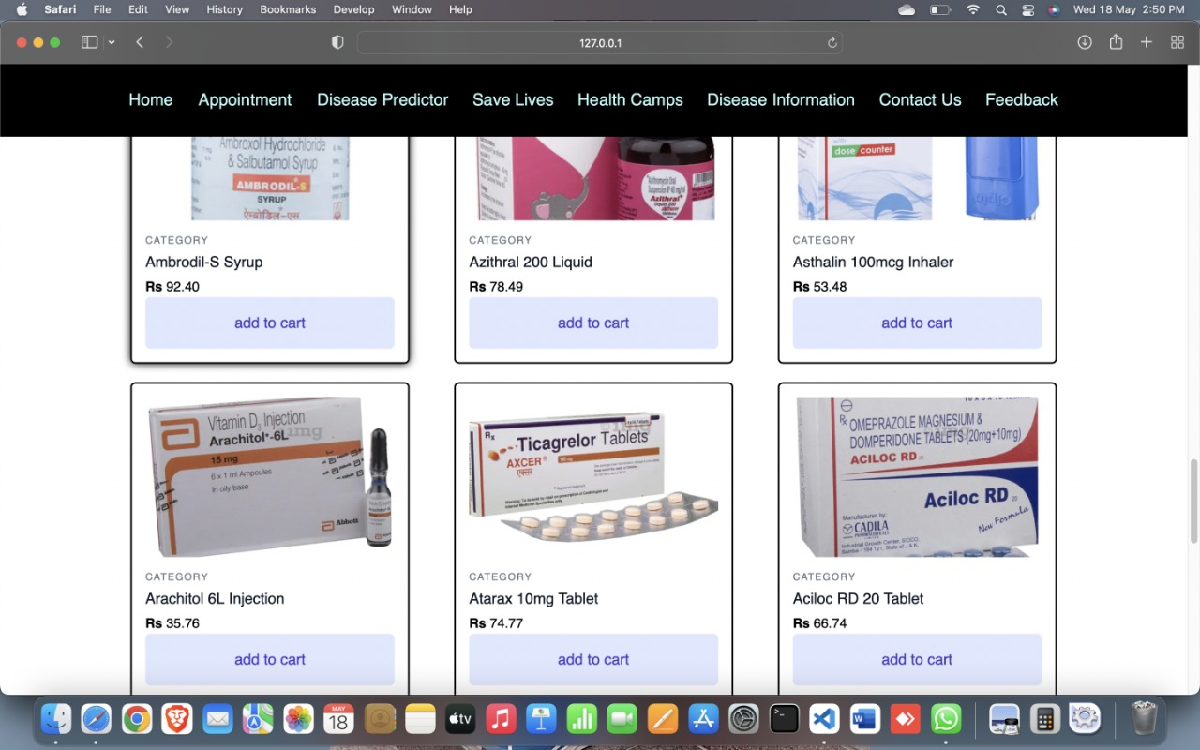
Results and Outputs- MEDICINE ORDER (MEDICINE AVAILABLE)-

Slide 20
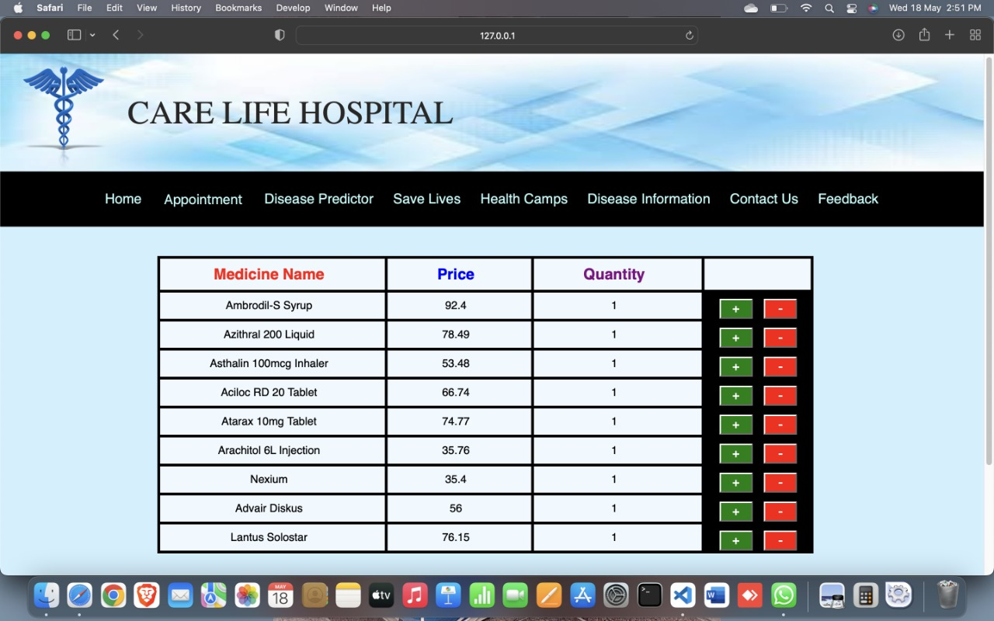
Results and Outputs- MEDICINE ORDER (MEDICINES IN CART)-

Slide 21
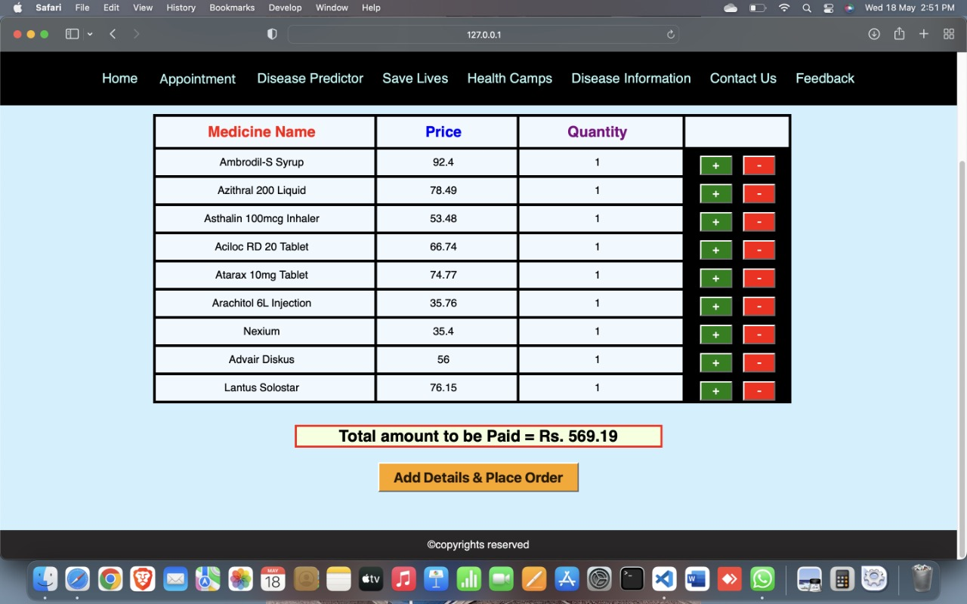
Results and Outputs- MEDICINE ORDER (MEDICINES IN CART)-

Slide 22
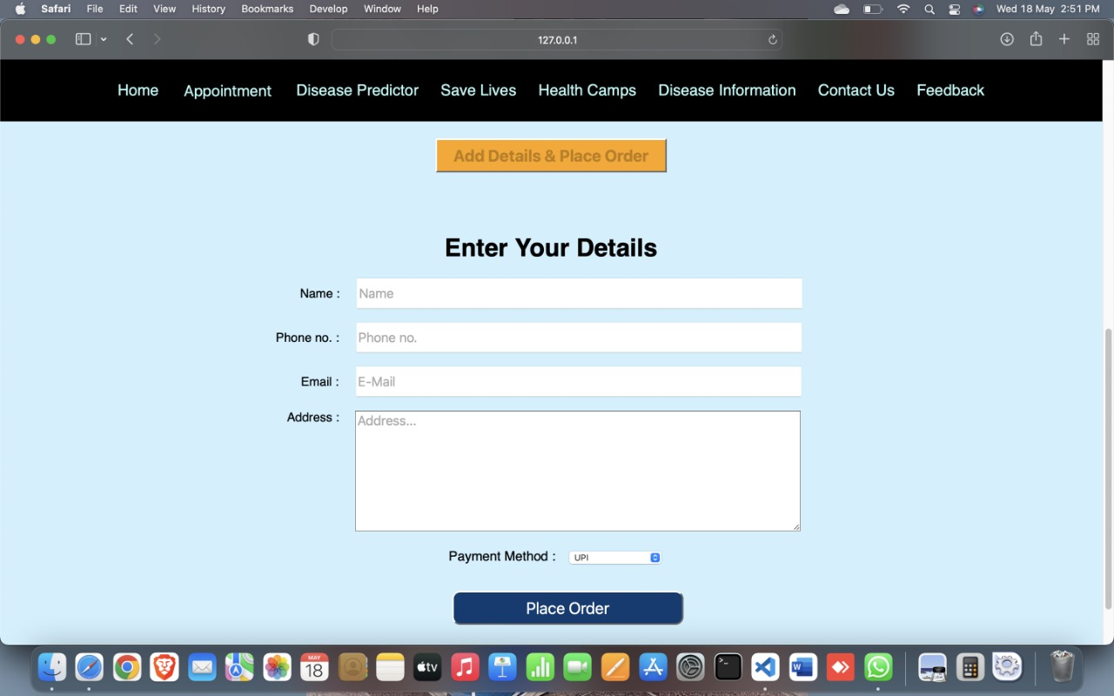
Results and Outputs- MEDICINE ORDER (ENTER YOUR DETAILS)-

Slide 23
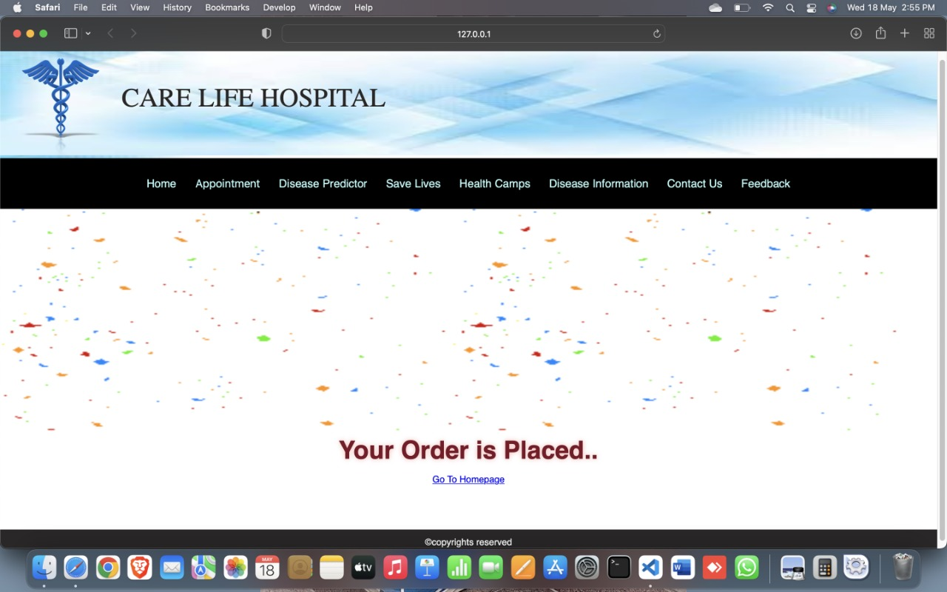
Results and Outputs- MEDICINE ORDER (ORDER IS PLACED)-

Slide 24
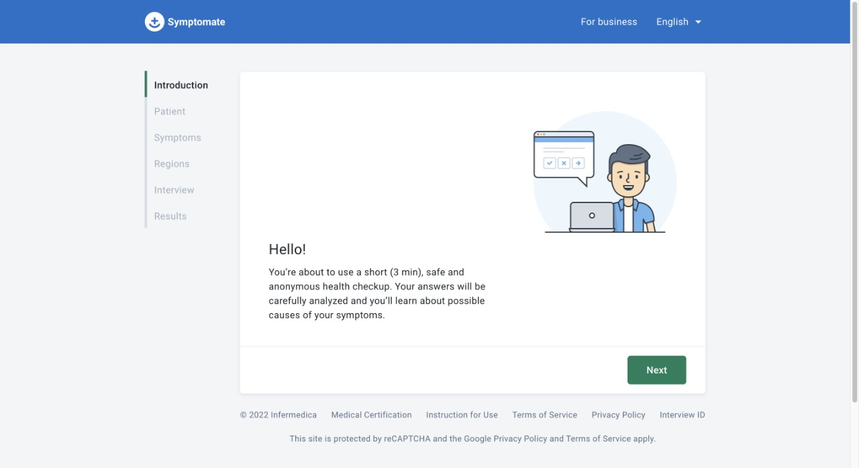
Results and Outputs- DISEASE PREDICTOR-

Slide 25
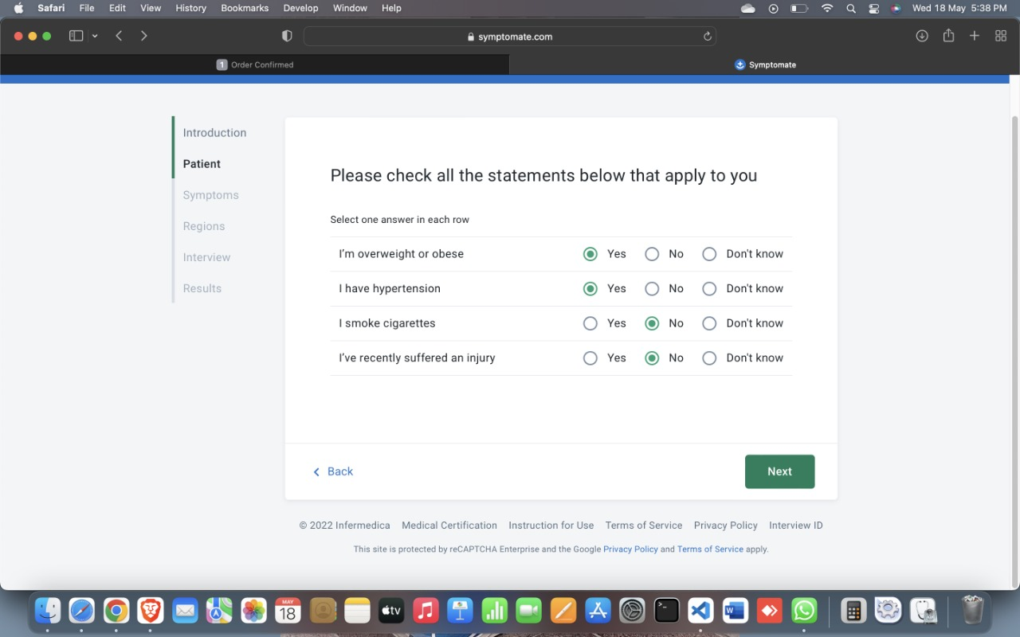
Results and Outputs- DISEASE PREDICTOR (ENTER SYMPTOMS)-

Slide 26
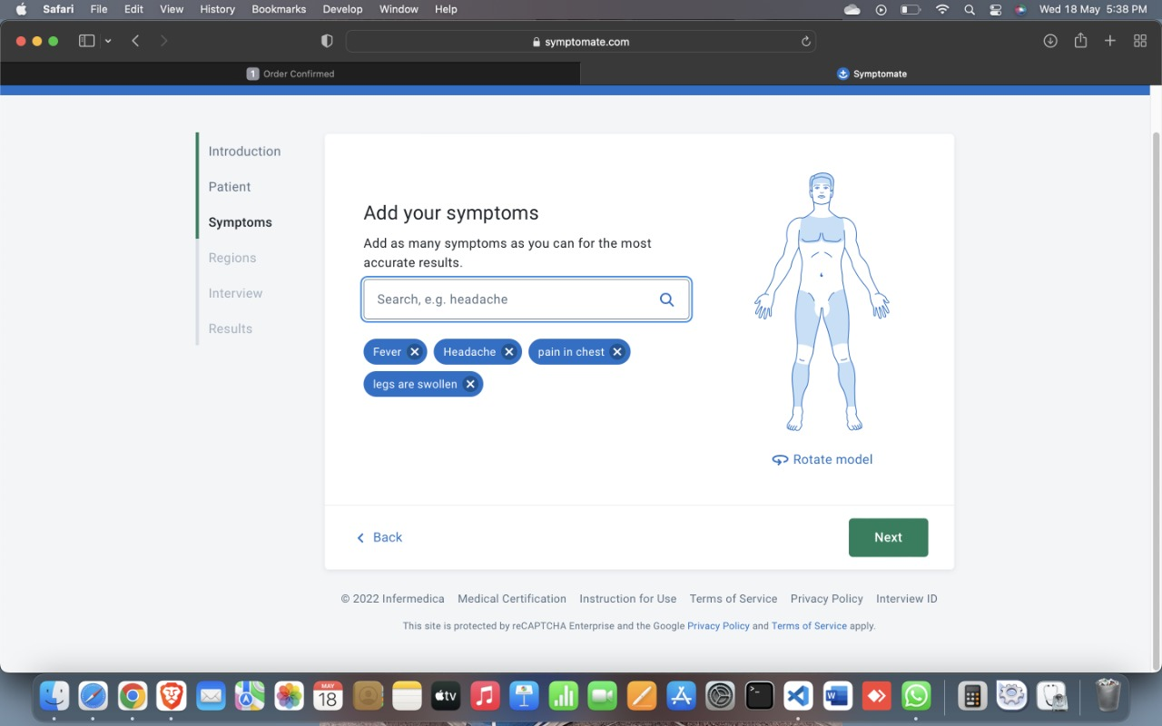
Results and Outputs- DISEASE PREDICTOR (ENTER SYMPTOMS)-

Slide 27
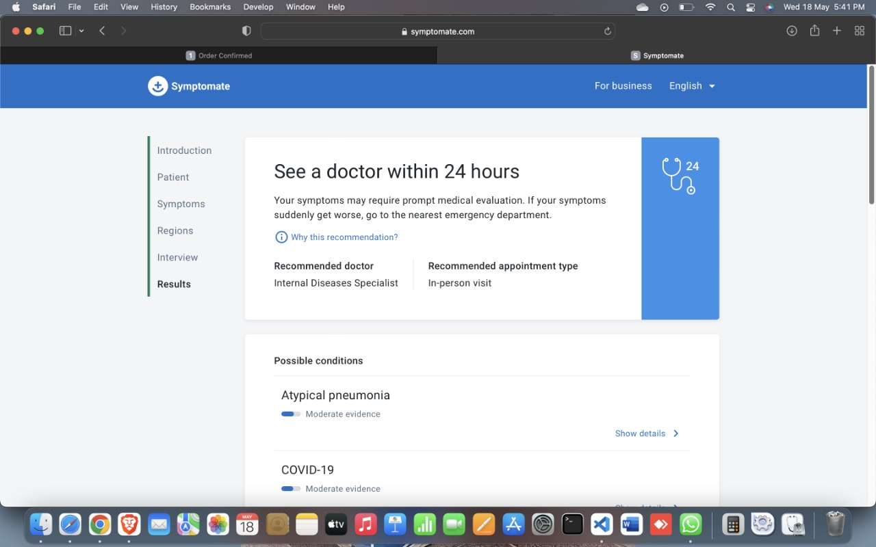
Results and Outputs- DISEASE PREDICTOR (POSSIBLE DISEASE)-

Slide 28
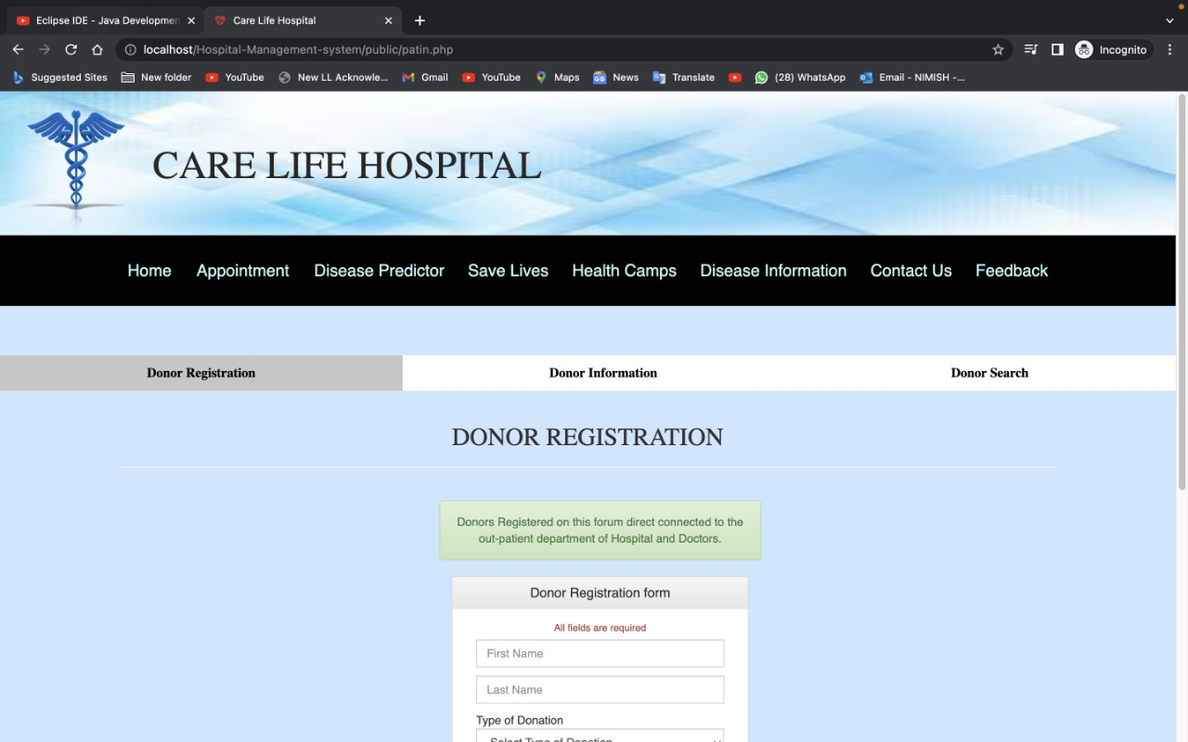
Results and Outputs- SAVE LIVES (DONOR REGISTRATION)-

Slide 29
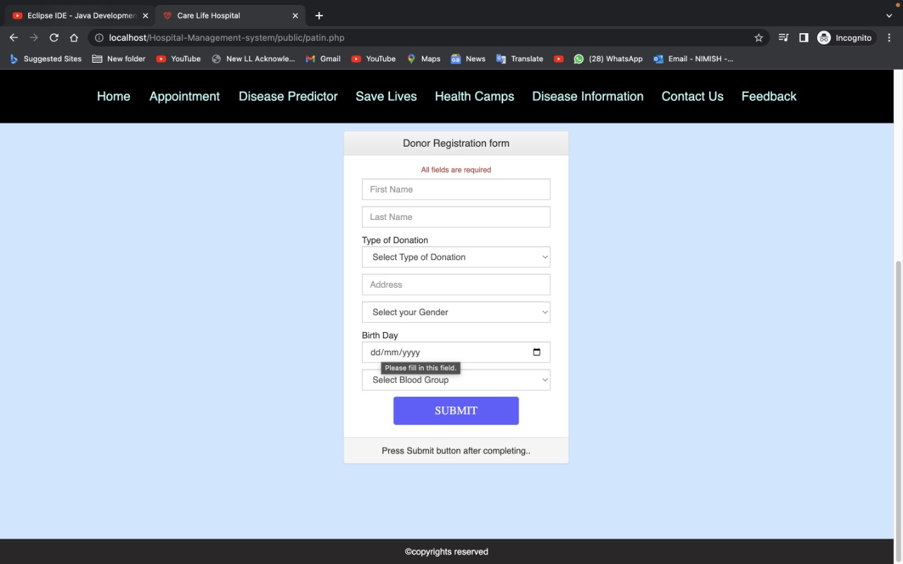
Results and Outputs- SAVE LIVES (ENTER DETAILS)-

Slide 30
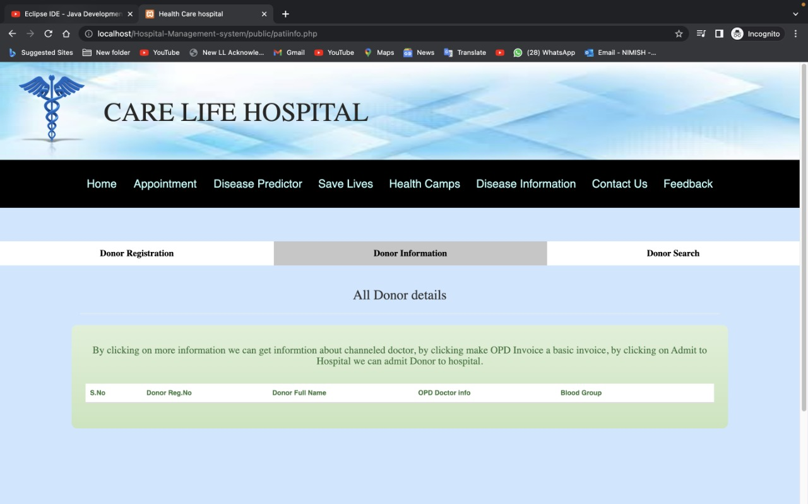
Results and Outputs- DONOR INFORMATION-

Slide 31
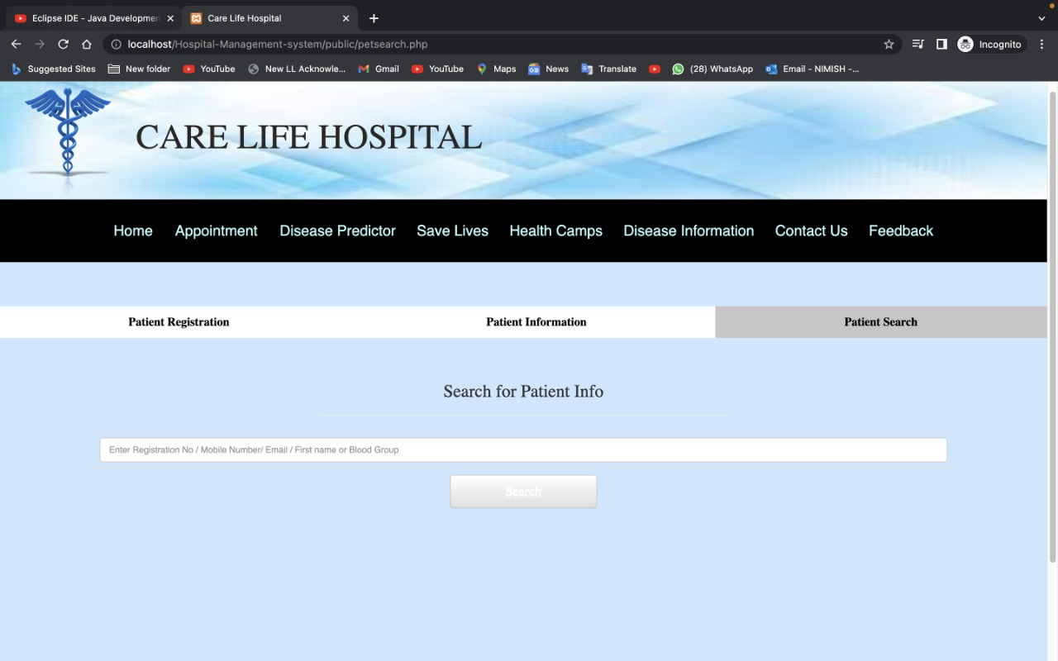
Results and Outputs- DONOR SEARCH-

Slide 32
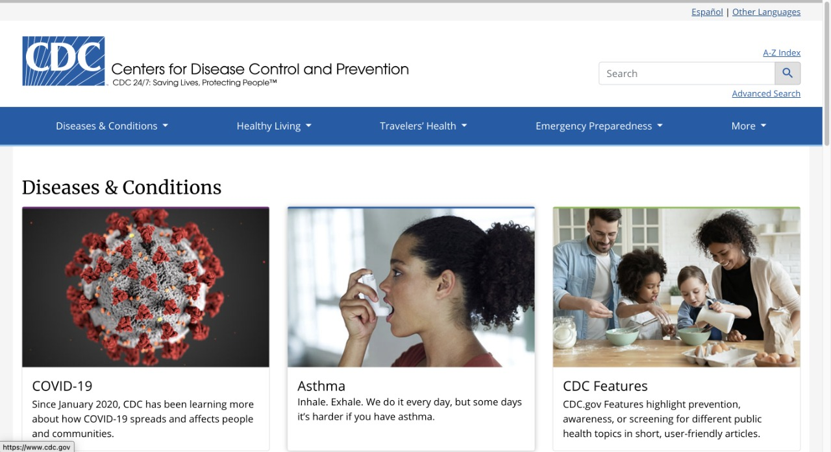
Results and Outputs- DISEASE INFORMATION-

Slide 33
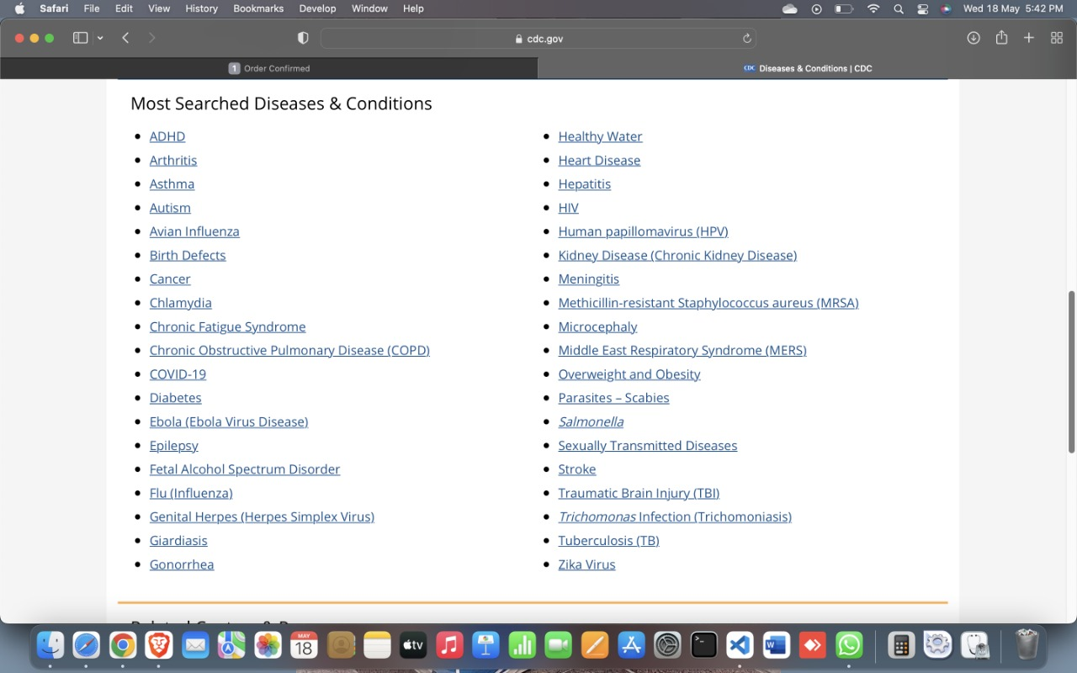
Results and Outputs- DISEASE INFORMATION (SELECT DISEASE)-

Slide 34
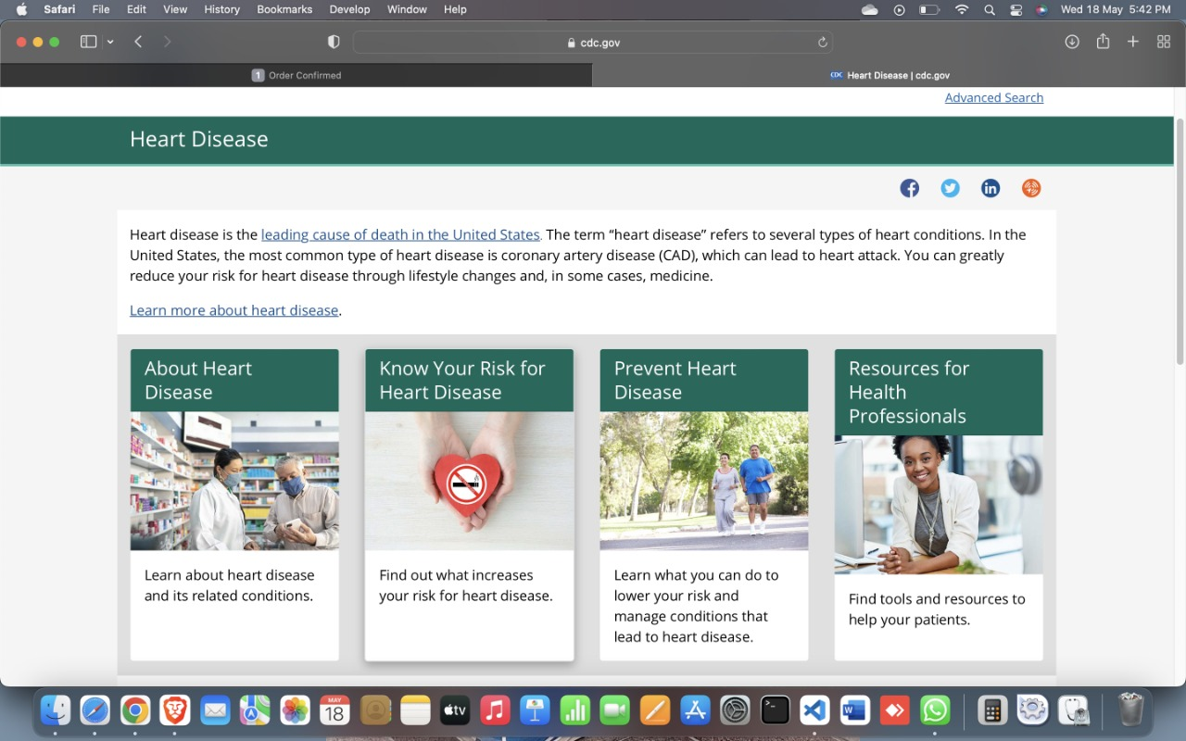
Results and Outputs- INFORMATION ABOUT DISEASE-

Slide 35
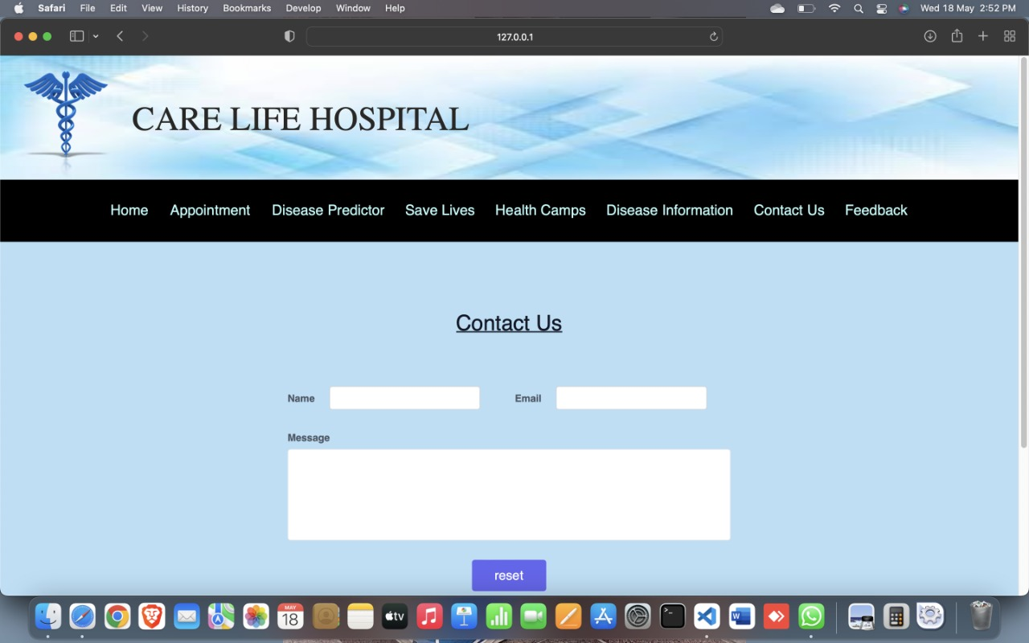
Results and Outputs- CONTACT US-

Slide 36
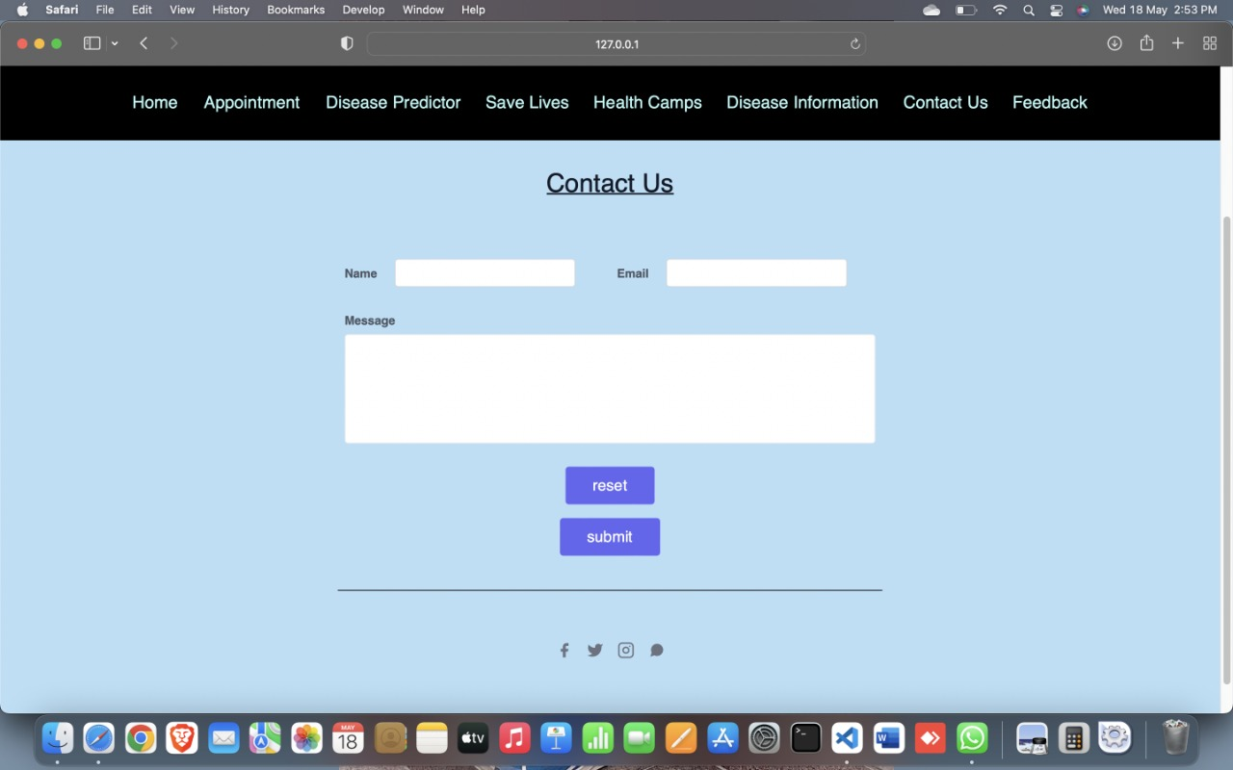
Results and Outputs- CONTACT US (ENTER YOUR QUERY)-

Slide 37
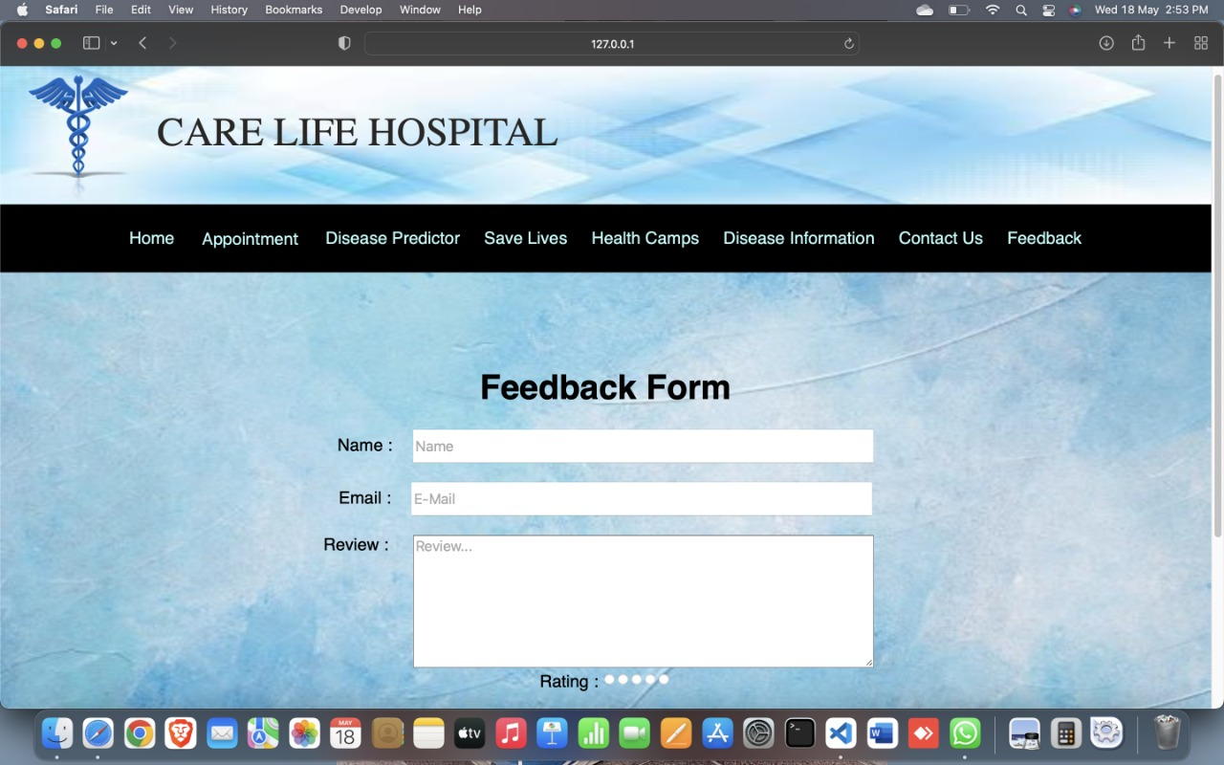
Results and Outputs- FEEDBACK FORM-

Slide 38
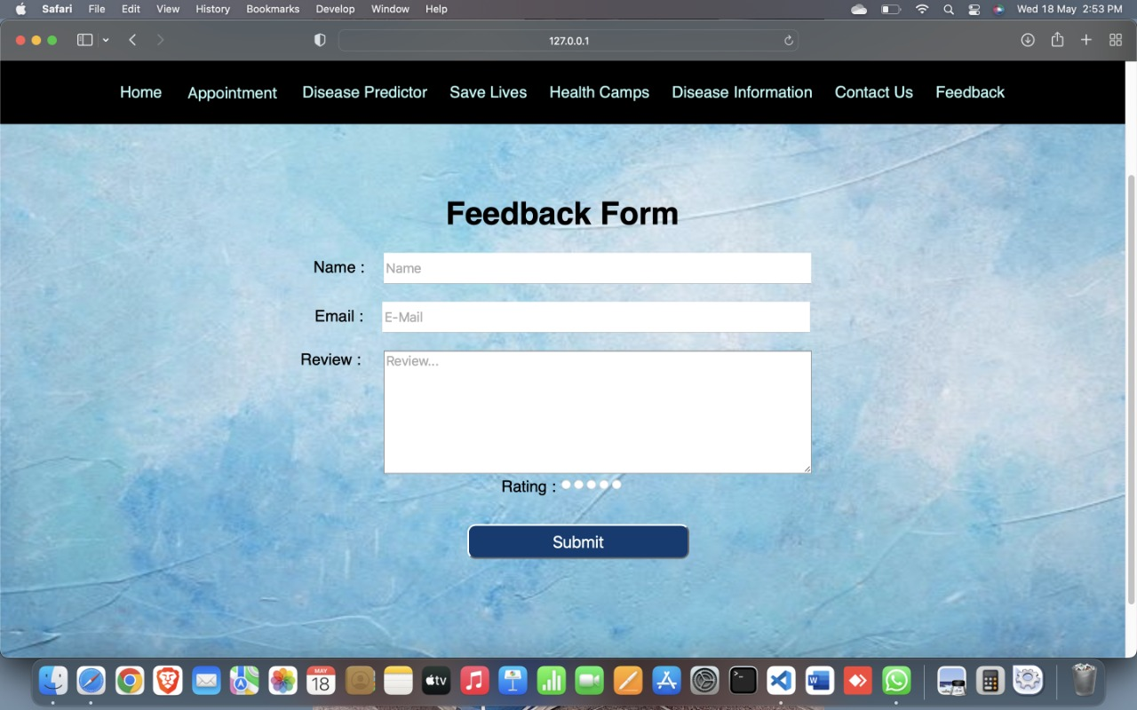
Results and Outputs- FEEDBACK FORM (ENTER YOUR REVIEW AND RATING)-

Slide 39
Conclusion-
In this project we had made a user friendly website for hospital management system in which user have certain options like booking an appointment with the doctor, order medicine online, donation (organs, blood), disease predictor (on the basis of symptoms), information about medical camps and also the information about the latest spreading or viral infections and also the precaution for them.
But it also have some pitfalls like: it does not show you the nearby medical facilities, it does not provide any online lab report of patients.

Slide 40
Future Scope-
Lab test reports will also be visible on website.
We will make its android app version also.
We will also include live chatbot assistance 24/7.
It will also show nearby pharmacy and clinics.

Slide 41
References-
https://medium.com/@datamateuaecrescent/hospital-management-system-features-objectives-62eeb13f4fc4
https://www.researchgate.net/publication/343149774_Hospital_Management_System
https://mocdoc.in/blog/a-detailed-view-of-hospital-management-system-hms
https://www.projecttopics.org/information-system-hospital-management.html
https://detailed-view-of-hospital-management-system-hms
https://www.topics.org/information-system-hospital-management.html
https://publication/343149774_Hospital_Management_System
https://Main%20objectives%20of%20a%20Hospital,management%20for%20better%20decision%20making

